Slide 1

Evaluating Sizing Effect on Recycled Continuous Carbon Fibres from Automotive Composites
2nd Eurecomp Webinar
16/07/2024
Dionisis Semitekolos, R Nano NTUA

Slide 2

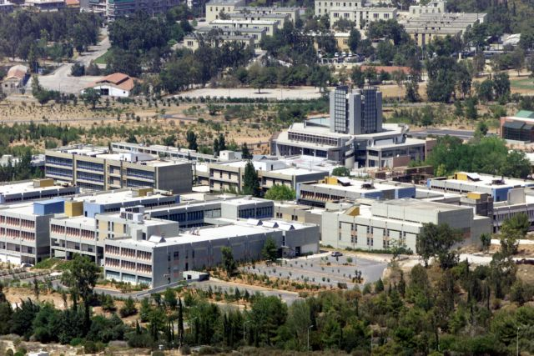

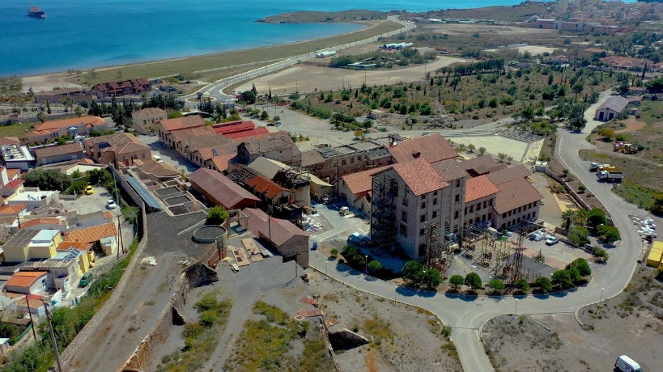
R-Nano Lab Facilities
Attica Region
Head:
Prof. Costas Charitidis
Professors (4)
Post Doctoral Researchers (14)
Researchers (11)
PhD (10)
Technicians (3)
Athens City Centre
Piraeus
Zografou Campus, School of Chemical Engineering
Lavrion Technological & Cultural Park
The "Research Unit of Advanced, Composite, Nano Materials & Nanotechnology", R-NanoLab is established since 2006;
has extensive experience in Designing, Production and Characterization of Advanced-, Composite- and Nano- Materials.

Slide 3
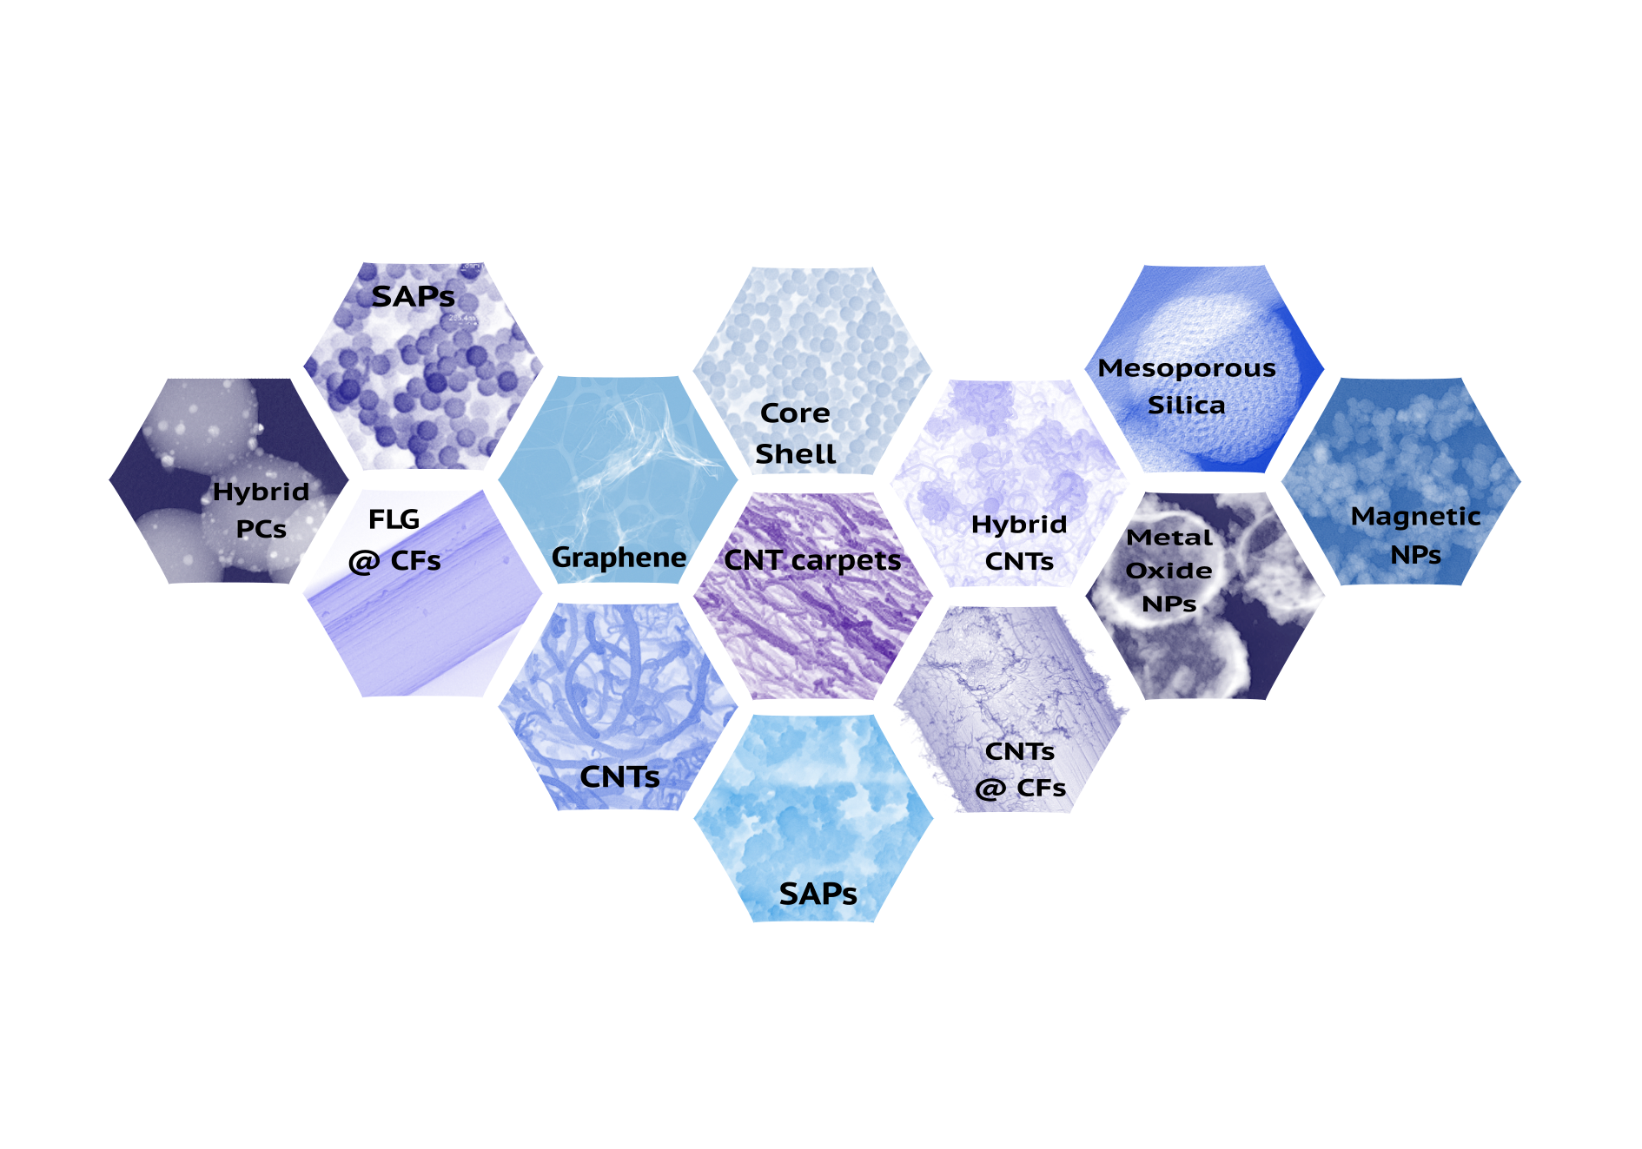










Main Pillars of Activity
Synthesis & (nano) Materials Development (C-based, Polymer based etc.)
Composites & Circularity (Fibre production, Surface Treatment & Sizing, Composite fabrication & testing, Chemical/ Thermal Recycling)
Thermoplastics processing & Circularity (compounding, extrusion, upcycling)
r-nano.gr

Slide 4
Introduction on Surface Treatment & Sizing of CFs
Electropolymerisation of CF fabrics
Development of nano-enhanced sizing solutions
Upgrade and evaluation of chemically recycled CFs
Sustainable sizing formulations

Slide 5
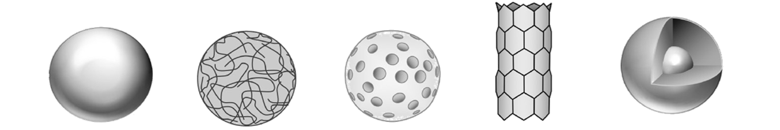
I. Introduction on Surface Treatment & Sizing of CFs

Slide 6
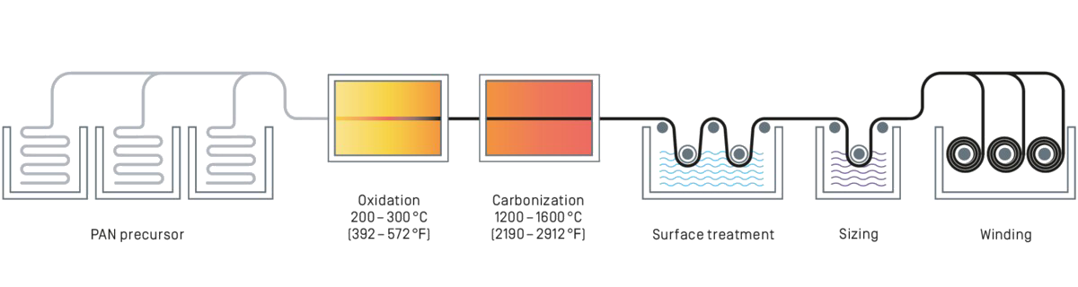
Introduction on Surface Treatment & Sizing of CFs
CF production line from PAN fibres
Image from:
https://www.sglcarbon.com/en/carbon-fibers-and-cfrp/

Slide 7
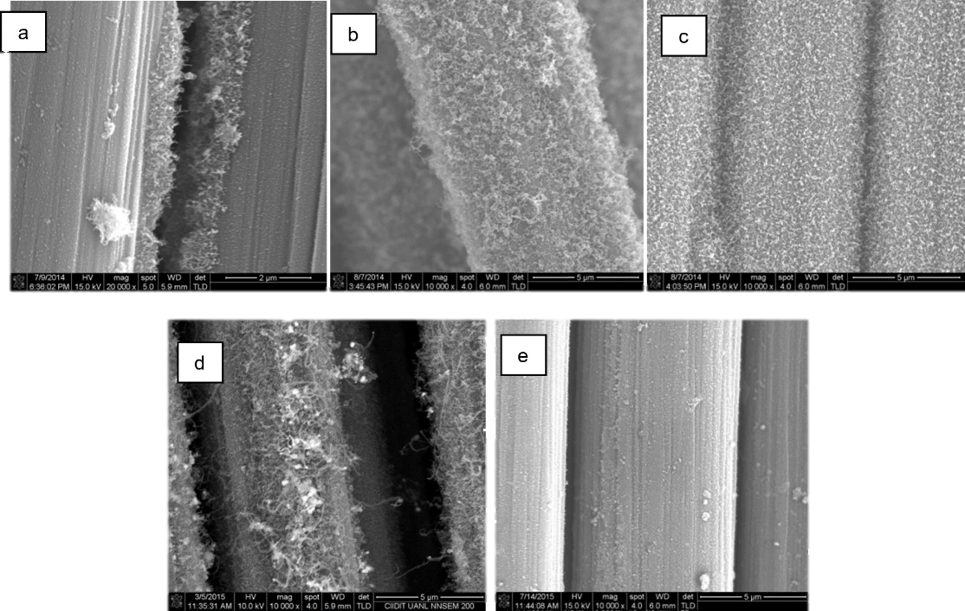
Introduction on Surface Treatment & Sizing of CFs
When a load is applied to the composite, stress is transferred to the fibers through the matrix. A weak bond between the matrix and the fiber leads to degraded mechanical properties
Surface CF treatment
Too powerful bond → Brittle and fragile composite
Weak treatment → low durability composite
ideal adhesion
fibre - matrix
https://link.springer.com/article/10.1007/s11051-019-4743-7

Slide 8
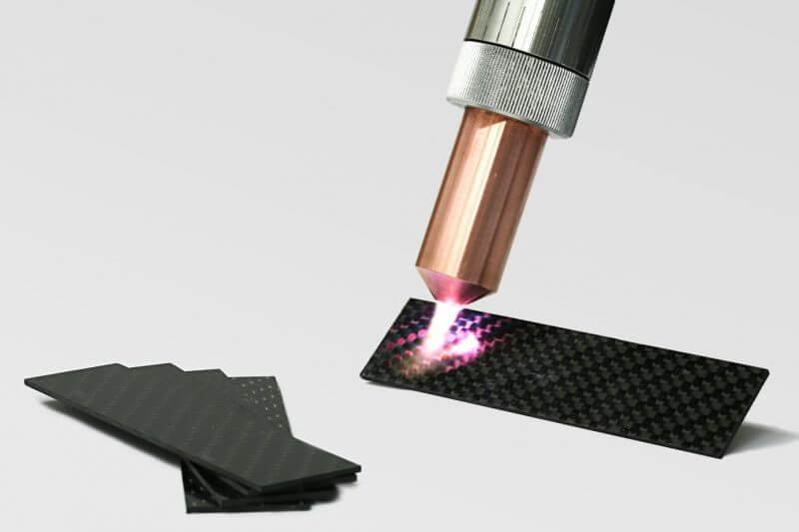
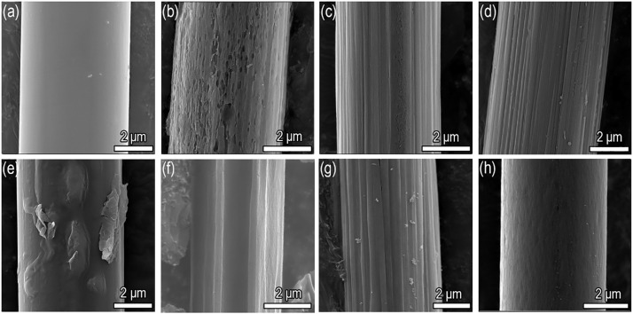
Introduction on Surface Treatment & Sizing of CFs
A successful surface treatment is bound to:
Increase the wettability of the fiber surface to the matrix resin by removal of the weak boundary layer, contaminant species or gas molecules adsorbed
Ensure the significant level of van der Waals interactions, which allow the matrix molecules to physically entangle with, or diffuse into, the molecular network of polymer CF coating
Promote mechanical interlocking between the fiber and the matrix, usually done by creating surface porosity into which resin molecules can penetrate
Increase the surface roughness, which will create new active sites on the fiber surface for subsequent chemical bonding with the unreacted species in the matrix resin
Attach a thin layer of 'coupling agent' that will chemically bond to both; fiber and matrix acting as a bridge
Image from:
https://www.intertronics.co.uk/2017/08/plasma-surface-treatment-for-bonding-composites/
https://doi.org/10.1016/j.matdes.2020.108633

Slide 9
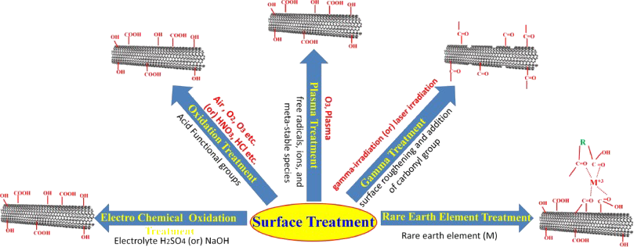
Introduction on Surface Treatment & Sizing of CFs
https://doi.org/10.1016/j.pcrysgrow.2018.07.001

Slide 10
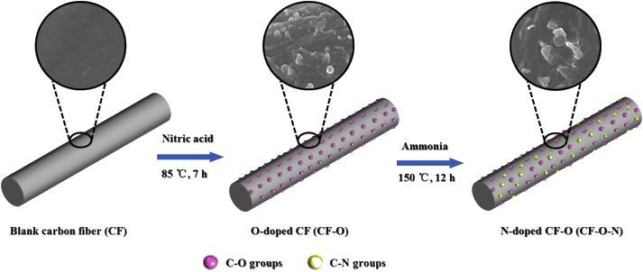
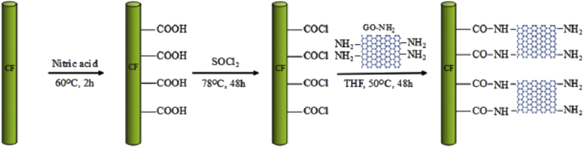
Introduction on Surface Treatment & Sizing of CFs
Oxidation
The basic means of achieving oxidation is through gases (by air, oxygen, ozone, etc.) or solutions (by HNO3, hydrochloric acid, etc.).
Parametres:
grade of CF being oxidized
concentration of oxidative medium
treatment time and
treatment temperature
https://doi.org/10.1016/j.ijhydene.2017.09.145
https://doi.org/10.1016/j.compositesb.2017.09.010

Slide 11
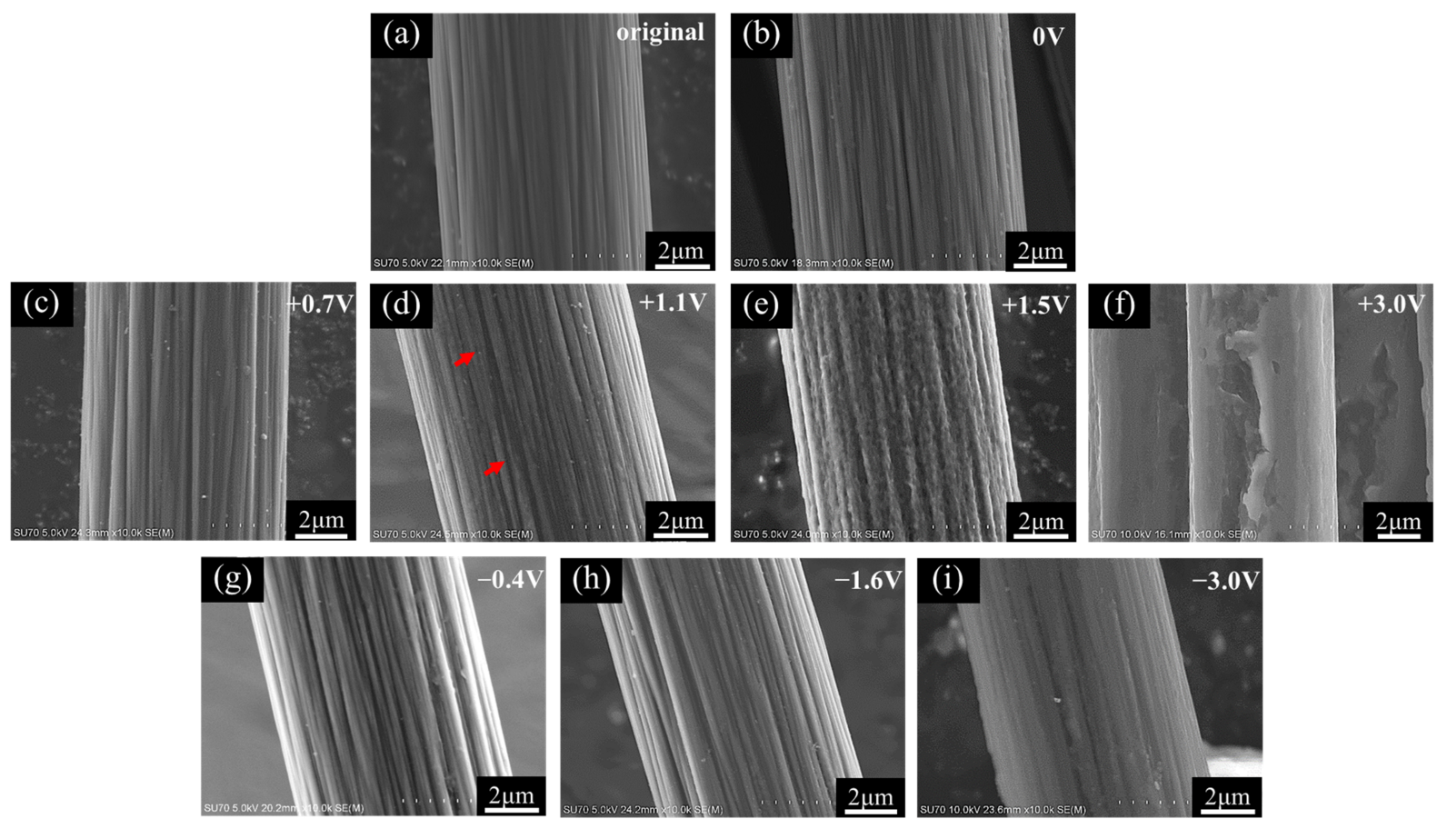
Introduction on Surface Treatment & Sizing of CFs
Electrochemical oxidation
Electrochemical oxidation is used the most often in industrial practice. The oxidation can be carried out in various electrolytes under the most diverse conditions.
Parameters:
type of electrolyte,
its pH,
the polarization potential,
the duration of the treatment and
the morphology of the surface
H₂SO₄ or NaOH
Oxidation may occur in acidic or basic electrolytic solutions
Galvanostatic or potentiostatic
Most commonly used NaOH, HNO₃, H₂SO₄, H₃PO₄, ΚΝΟ₃ and ammonium salts
Increase in the number of surface functional groups in the fibers
https://doi.org/10.3390/ma14071758

Slide 12
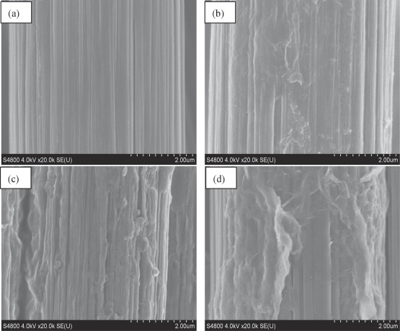
Introduction on Surface Treatment & Sizing of CFs
Carbon fiber grafting
Chemical vapor deposition
Chemical grafting
Irradiation grafting
Graphitic structure by design
Electropolymerisation
describes an electrochemical process where monomers are polymerized in solution on the surface of an electrode or in the vicinity of it.
Advantages
controlling the thickness
functionality of a ‘reactive’ coating through selective processing parameters
uniform coatings
https://doi.org/10.1016/j.compositesa.2019.01.014

Slide 13
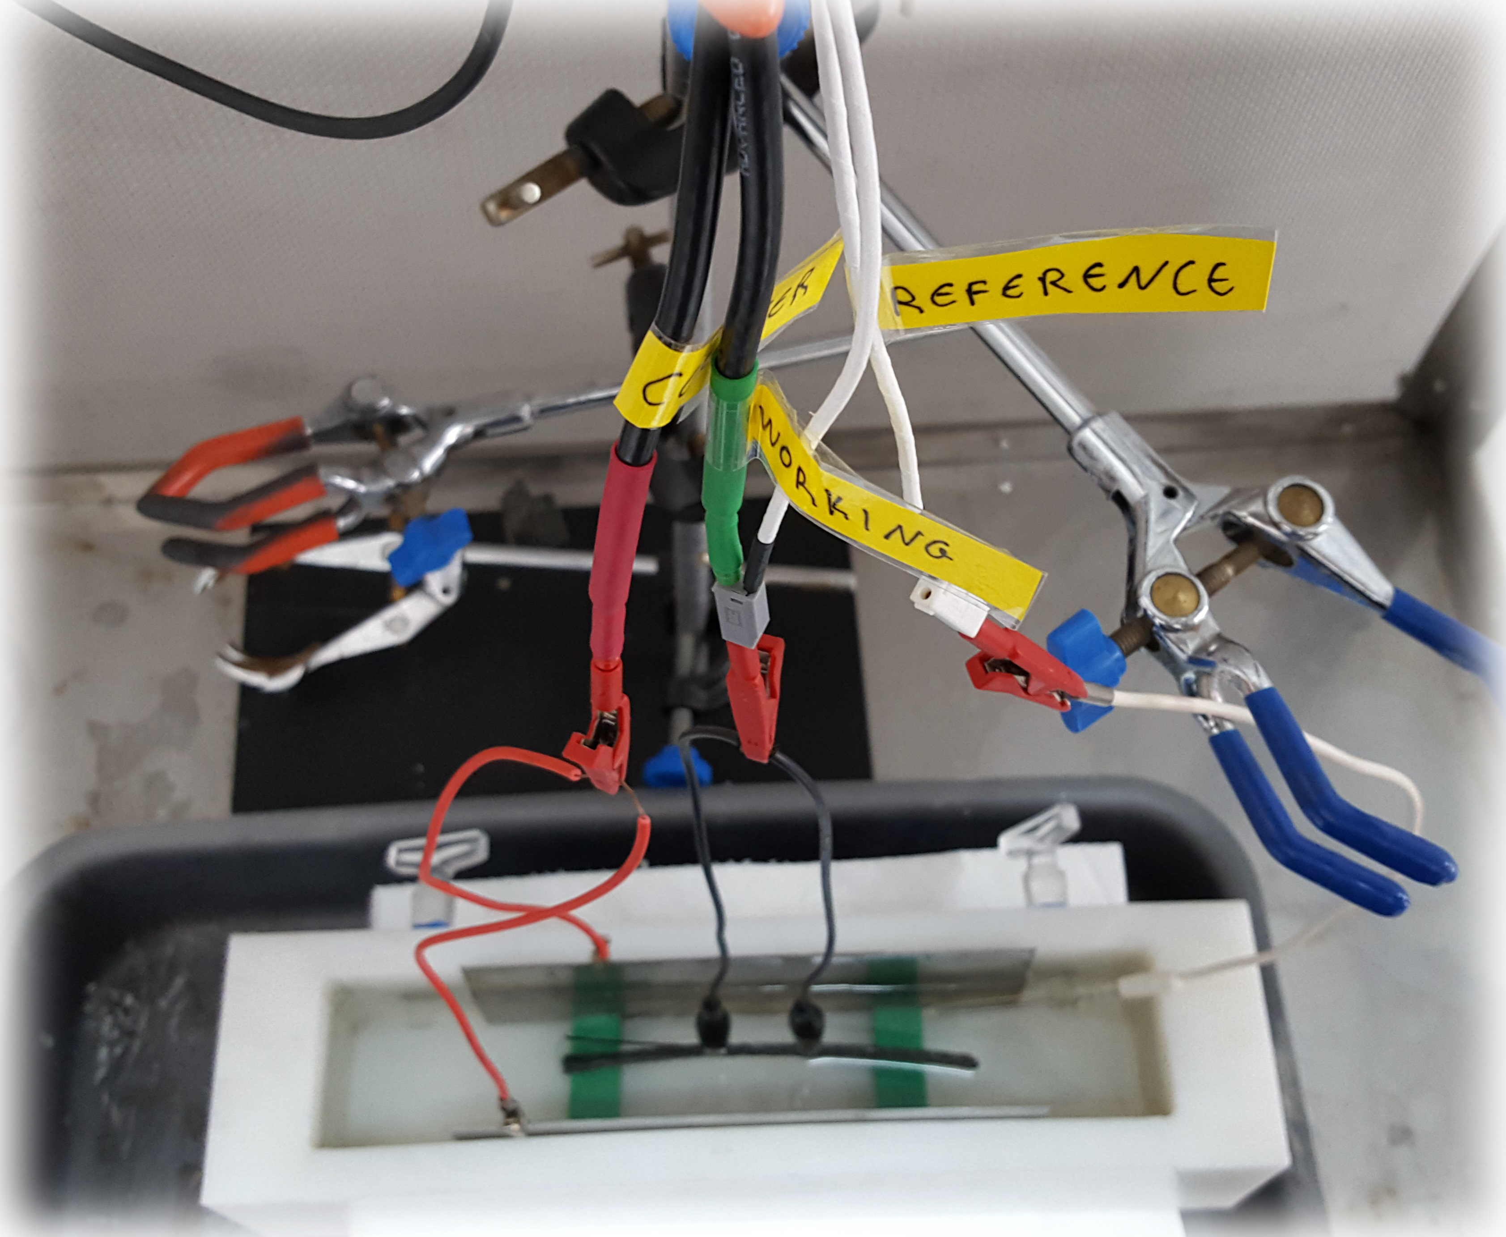

II. Electropolymerisation of CF fabrics
https://doi.org/10.3390/nano11102631
https://doi.org/10.3390/polym13234092
https://doi.org/10.3390/polym15030768
https://doi.org/10.1016/j.mtcomm.2022.103854
https://doi.org/10.1016/j.compstruct.2021.114780

Slide 14
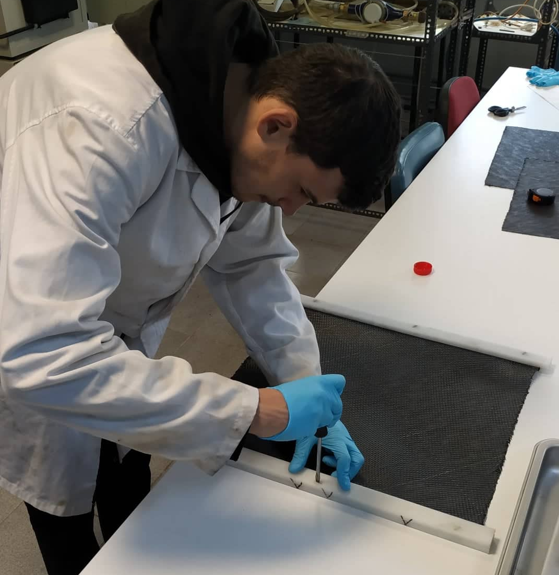
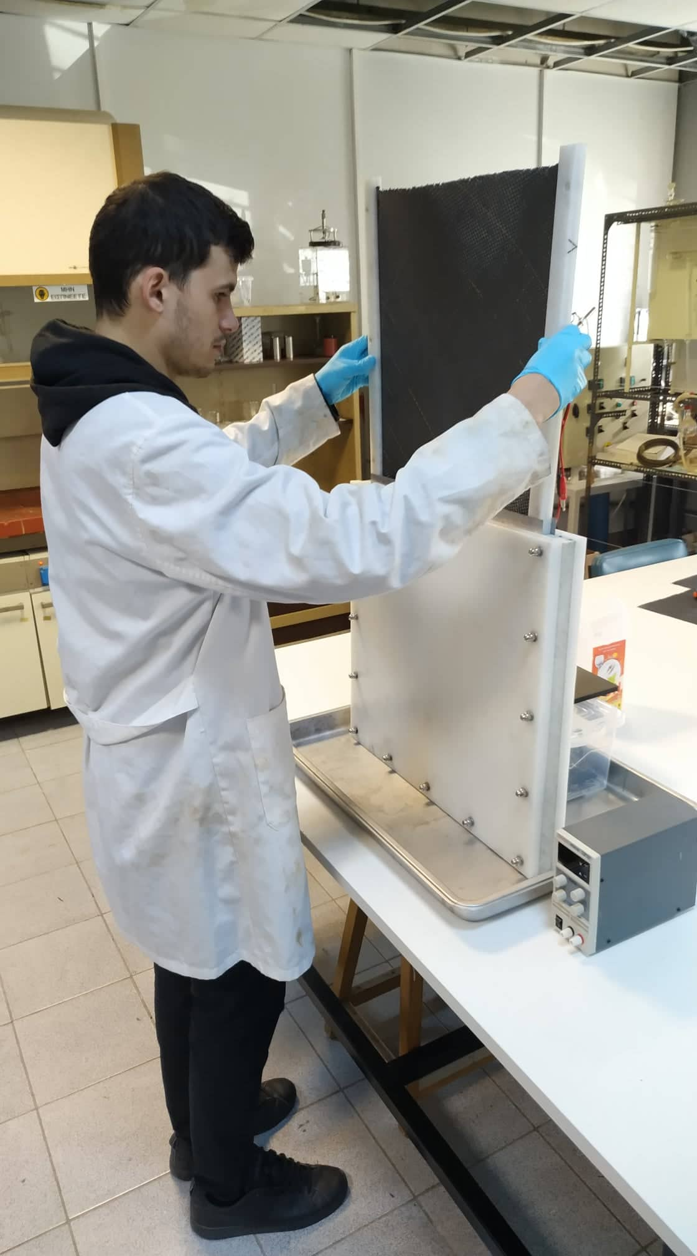
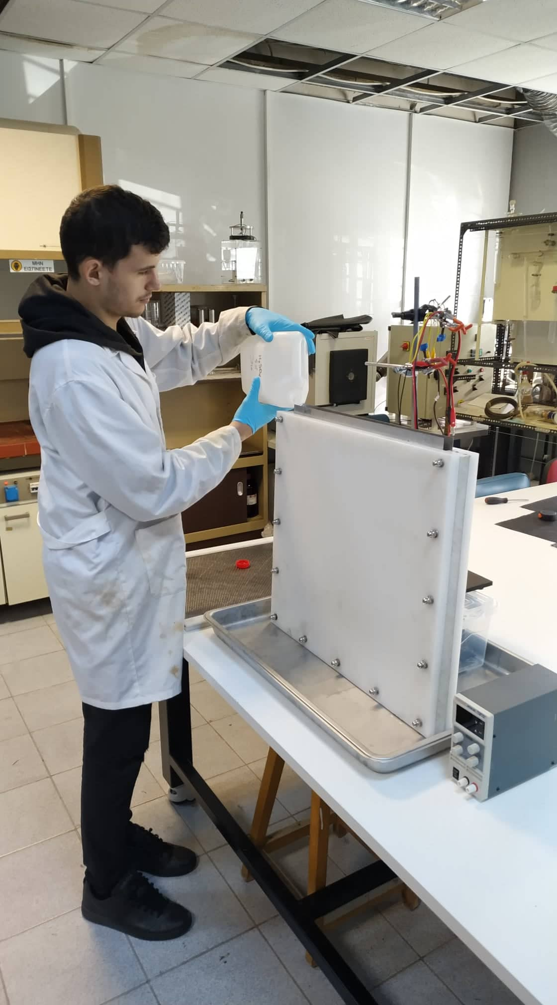
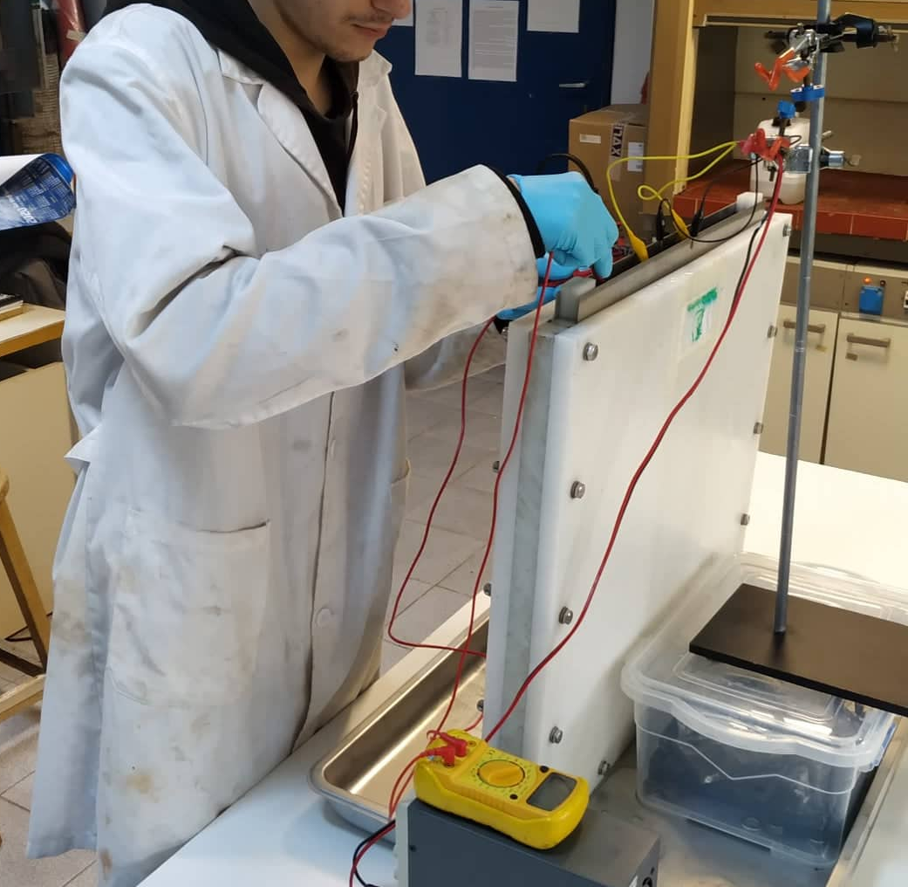
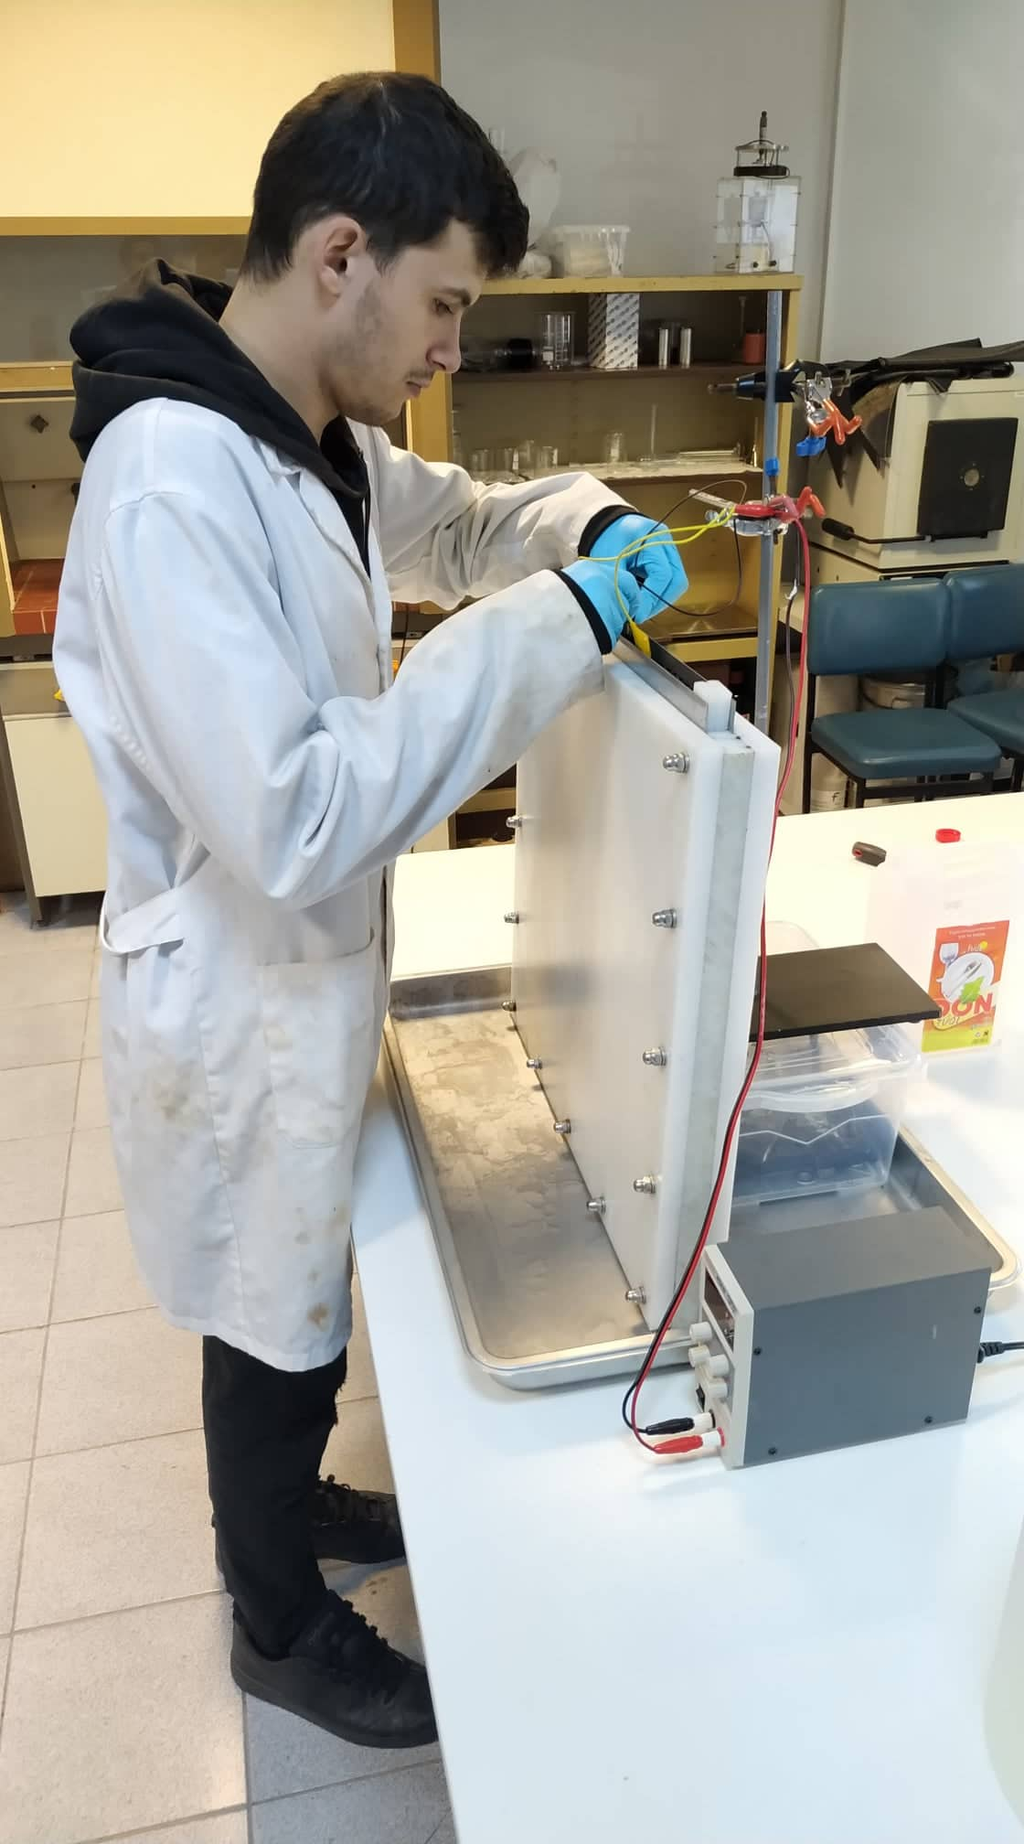
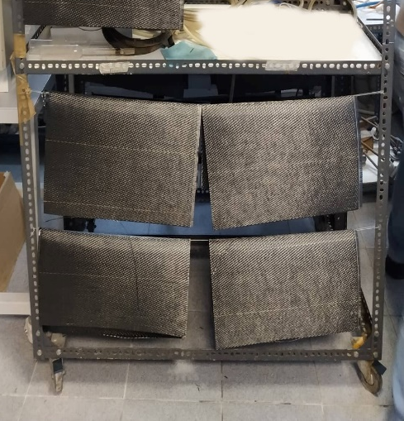
Electropolymerisation of CF fabrics
2 Stage Process;
1st cyclic voltammetry,
2nd electropolymerization
Aqueous solution H₂SO₄ 5%
10 scanning cycles
-3V → 3V → -3V
Cycle rate
0,1V/s
Aqueous Solution
0,3M MAA
0,4M ZnCl₂
10mM N, N’ methylene bis acrylamide
Voltage
-0,435V
time 1h

Slide 15
Electropolymerisation of CF fabrics
Cyclic Voltammetry
a
b
c
d
Formation of stage II, C₄₈⁺ HSO₄⁻ •2H₂SO₄ (intercalated anion per two graphene layers)
Formation of stage I, C₂₄⁺ HSO₄⁻ •2H₂SO₄
(intercalated anion per graphene layer)
Further oxidation to partially covalent graphene oxide
Reduction of surface oxides, defect oxides and partially reduced GO

Slide 16
Electropolymerisation of CF fabrics
Electropolymerization
Thickness of polymer film can be derived by Faraday’s Law, taking advantage of the area below the graph that equals to the electric charge that passes through the CF

Slide 17
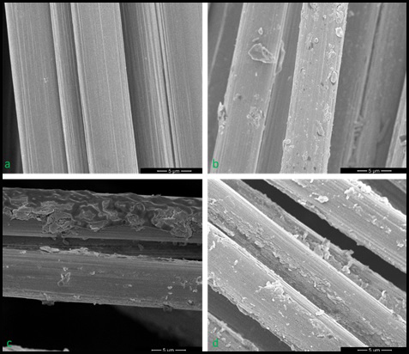
Introduction on Surface Treatment & Sizing of CFs
Scanning Electron Microscopy/ Atomic Force Microscopy
Smooth
Pristine
b. Electrochemical
c/d. Electropolymerised
Rigged
Roughness increase
Exfoliation
Coating

Slide 18
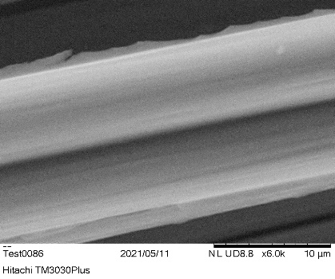
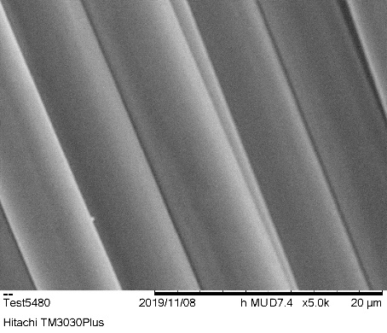
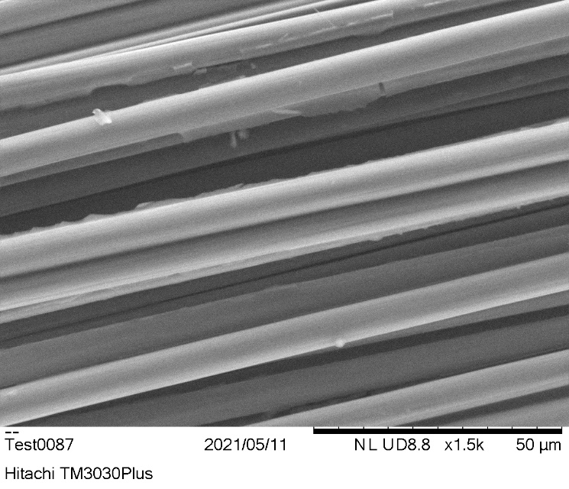
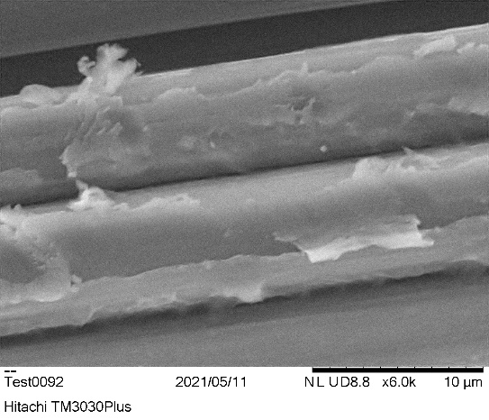
Electropolymerisation of CF fabrics
SEM analysis
Untreated T700
Electropolymerised T700
Rigged and smooth surface
Electropolymerised T700
Graft Polymerisation
Surface roughness
coating

Slide 19
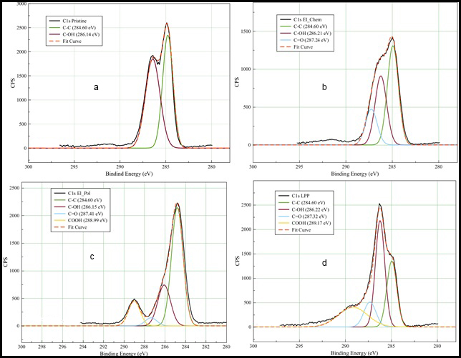
Electropolymerisation of CF fabrics
X-ray spectroscopy
α. pristine:
b. electrochemical:
c. electropolymerised:
C-C, C-OH
C-C, C-OH, C=O
C-C, C-OH, C=O,
COOH
18.4 % O₂
18.8 % O₂
26.5 % O₂

Slide 20
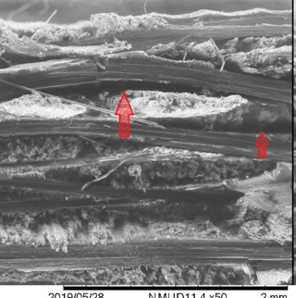
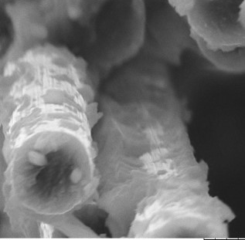
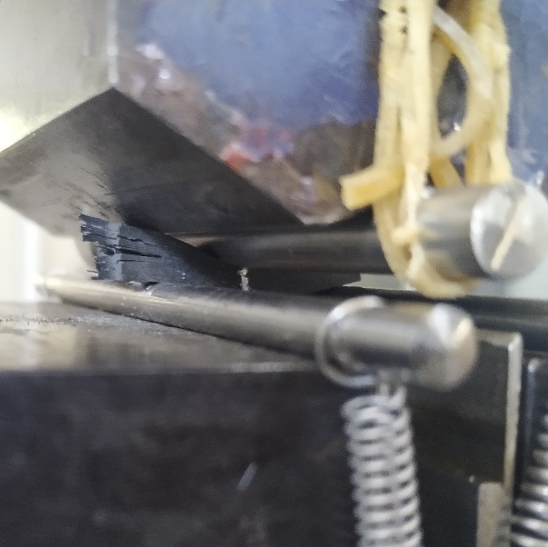
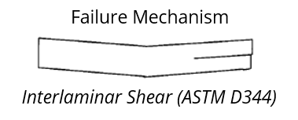
Electropolymerisation of CF fabrics
Mechanical Properties
Treated fibres coated
with epoxy
Severe delamination
on Reference
+ 36.2% electropolymerised
+ 16.2% electropolymerised

Slide 21
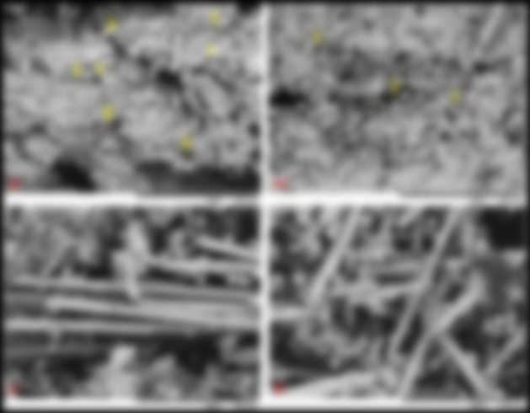
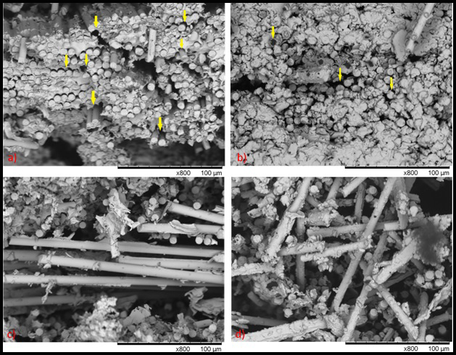
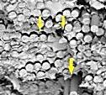
Electropolymerisation of CF fabrics
a, c pristine
Voids
Detached “naked” fibres
Separated interface
b,d electropolymerised
Fewer voids
Fractured fibres with epoxy on surface
Dwindled separated interfaces

Slide 22
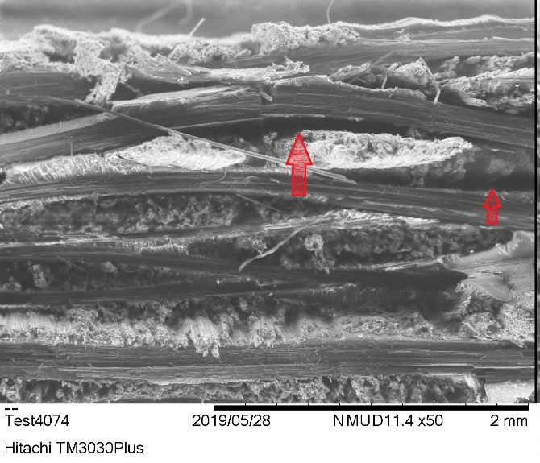
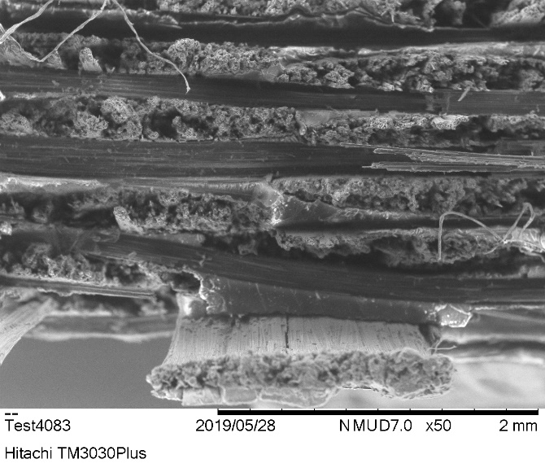


Electropolymerisation of CF fabrics
Fracture Analysis
Severe delamination on reference sample
Treated fibres are coated with the matrix even after failure

Slide 23
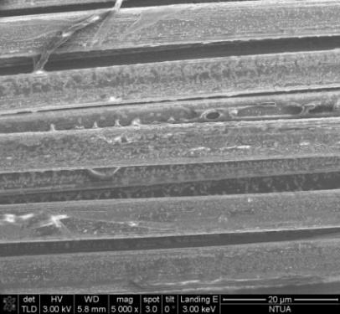
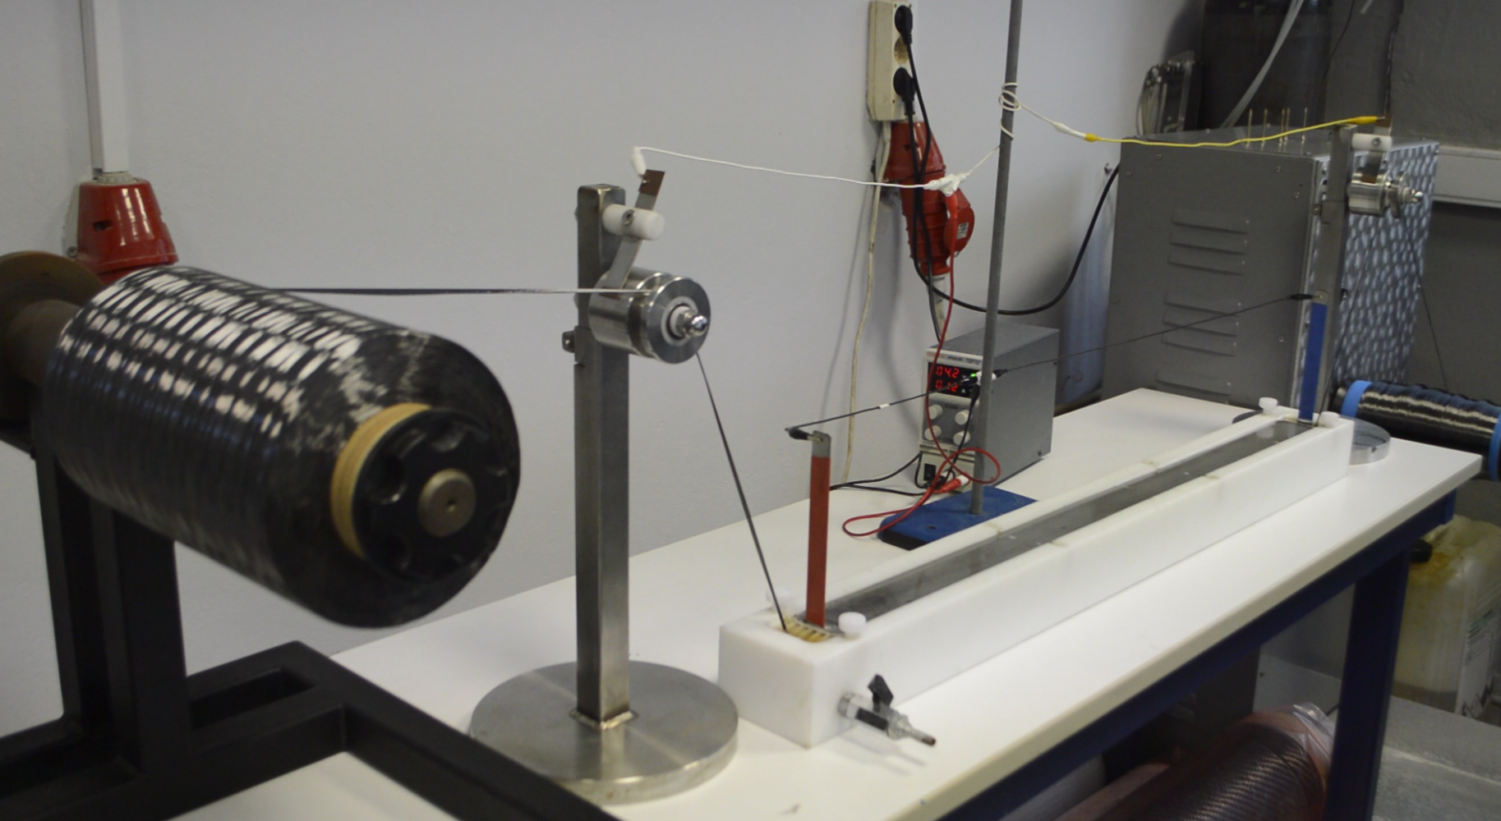
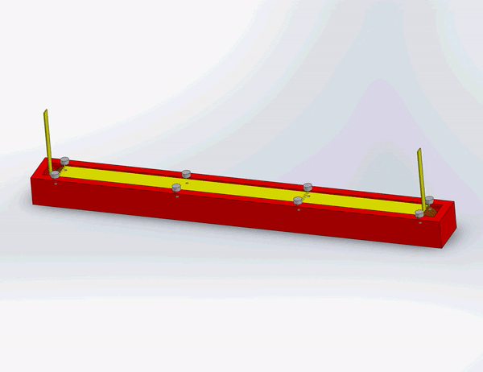
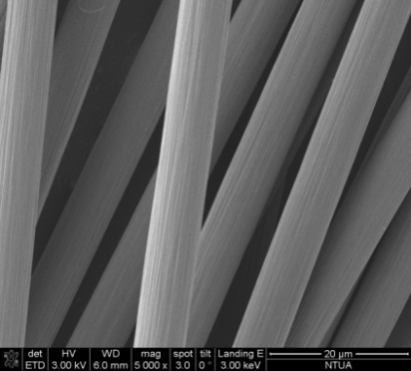
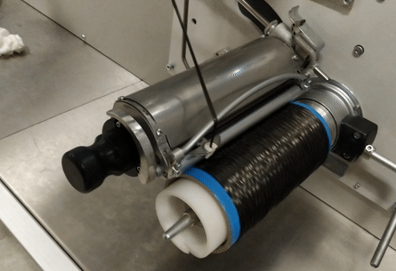
Electropolymerisation of CF fabrics
Surface treatment on CFs via electropolymerisation of MAA
Designed & Manufactured by R-Nano Group
PMAA@CFs
CFs
Automated Take up

Slide 24

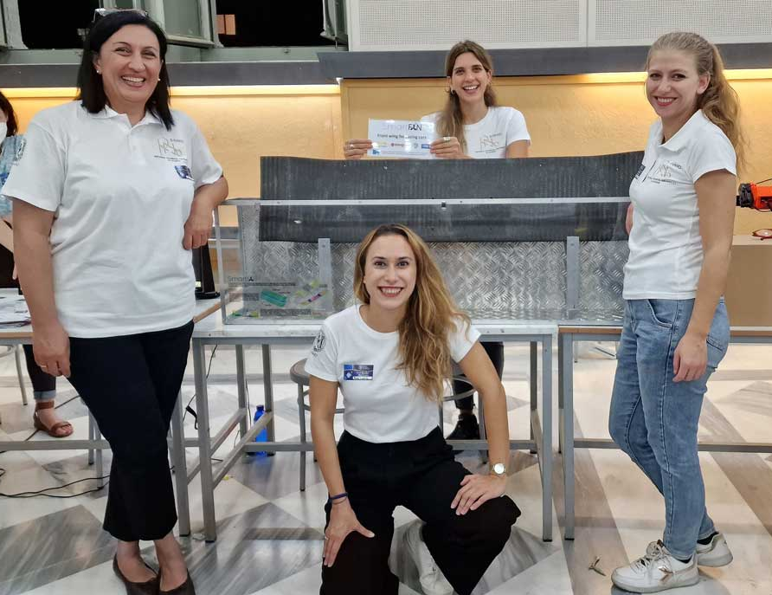
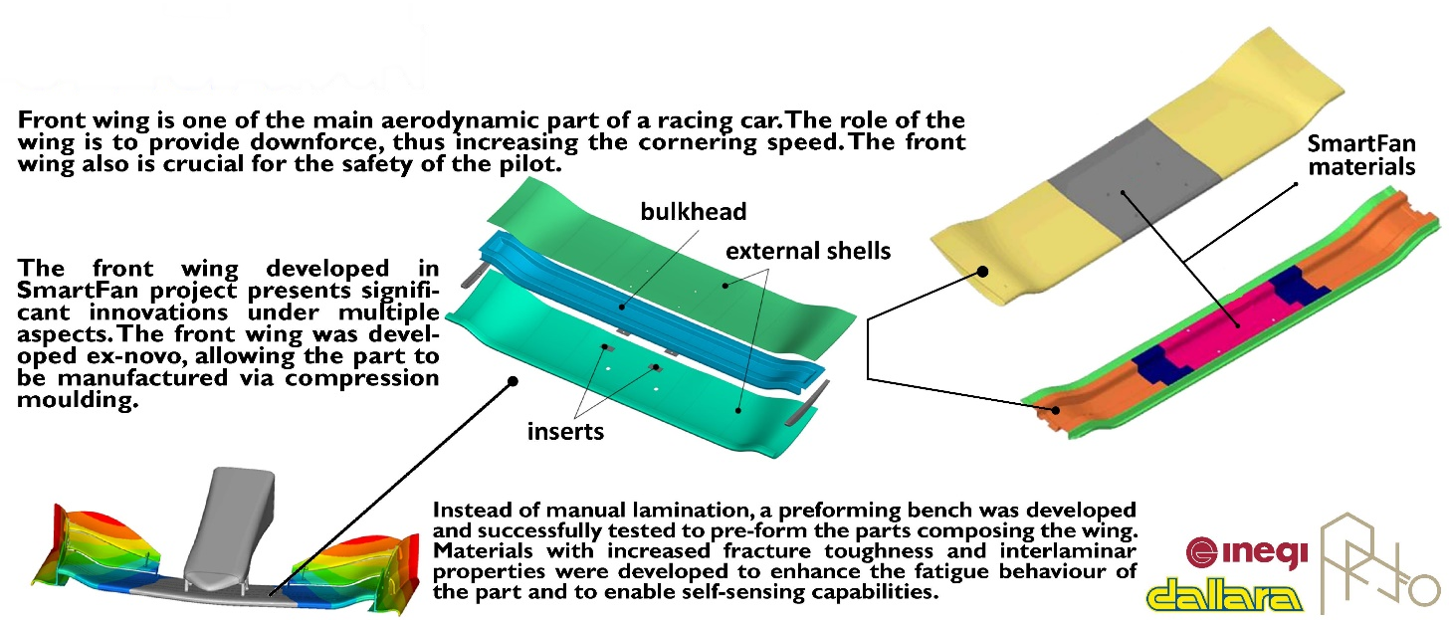
Fabrication of a front wing for racing car with modified materials

Slide 25
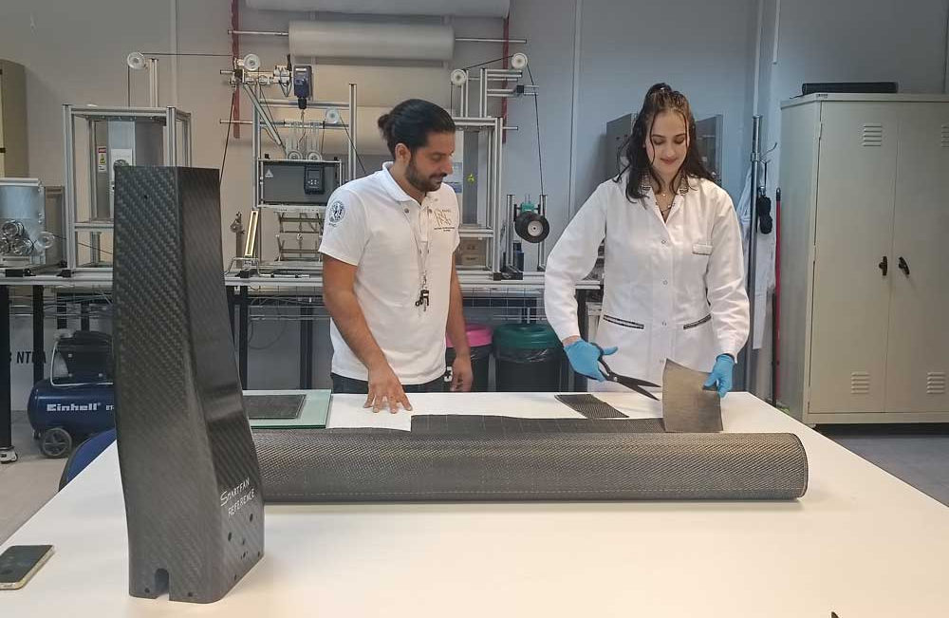
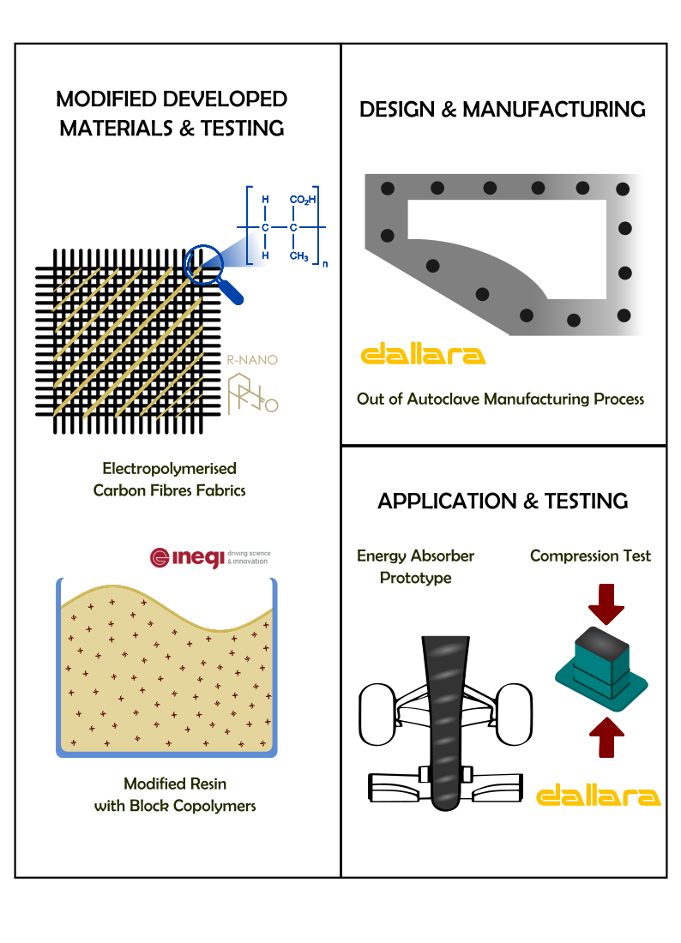
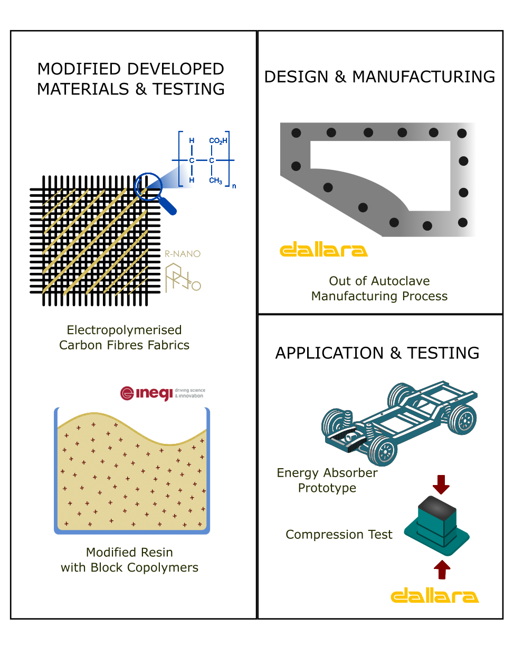

Fabrication of energy absorber for automotive with modified materials

Slide 26


III. Development of nano-enhanced sizing solutions for carbon fibres
https://doi.org/10.3390/fib12020016
https://doi.org/10.3390/recycling9030037

Slide 27

Development of nano-enhanced sizing solutions for carbon fibres
Goal: Develop water based nano enhanced sizing solutions to improve compatibility of carbon fibres with 3R resins and apply functionality
Motivation
Challenges:
Agglomeration of nanomaterials
Stable solutions
Effective desizing
Uniform coatings
Upscaling

Slide 28
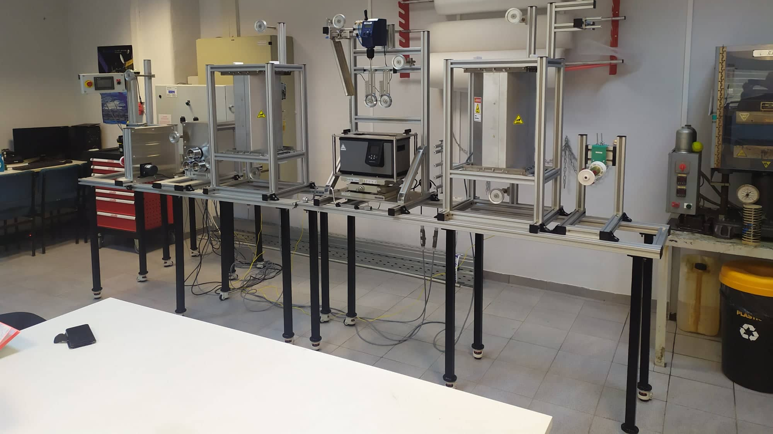
Pilot scale carbon fibre sizing line

Slide 29
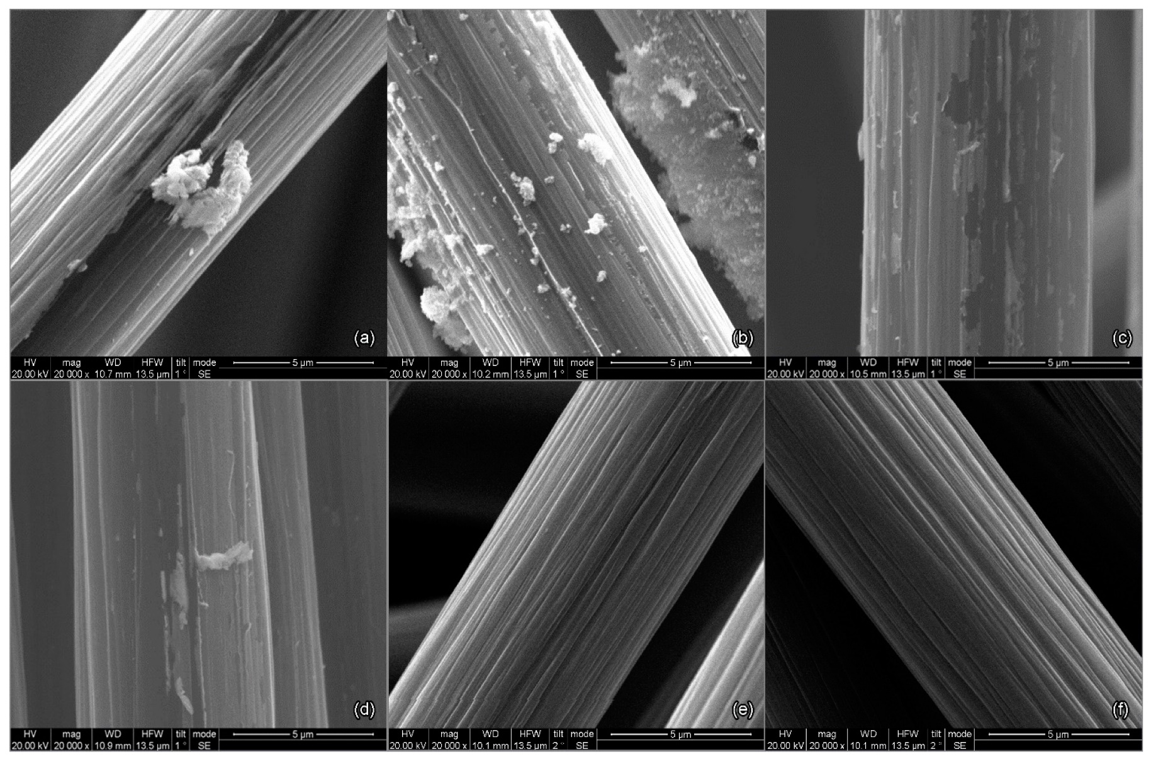
Development of nano-enhanced sizing solutions for carbon fibres
Temperature parametric study of sizing removal,
operation speed 0.2m/min
350ºC, (b) 400ºC, (c) 450ºC,
(d) 500 ºC, (e) 550ºC, (f) 600ºC

Slide 30
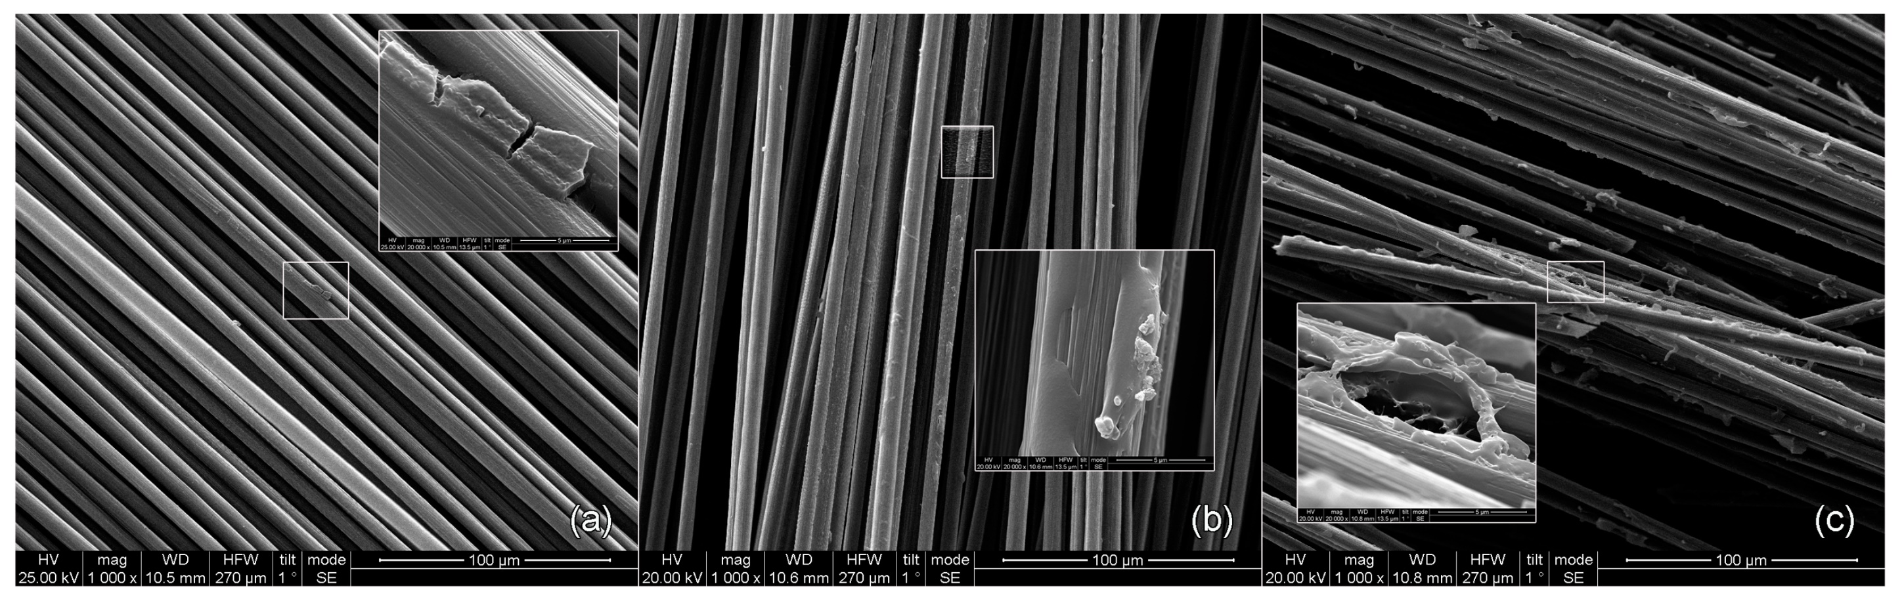
Development of nano-enhanced sizing solutions for carbon fibres
Solid content concentration study of (a) 1, (b) 2.5 and (c) 5%w at 1000x magnification, and 20000x magnification

Slide 31
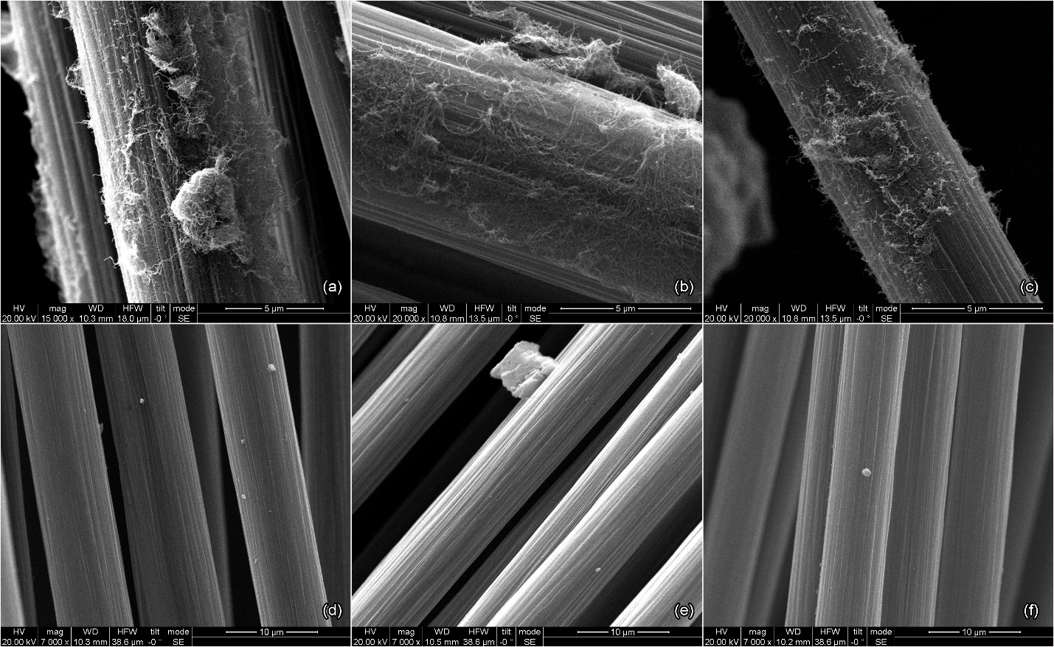
Development of nano-enhanced sizing solutions for carbon fibres
Surface morphology study of
CNTs O2,
(b) CNTs N2,
(c) CNTs NH3,
(d) FLG O2,
(e) FLG N2,
(f) FLG NH3

Slide 32
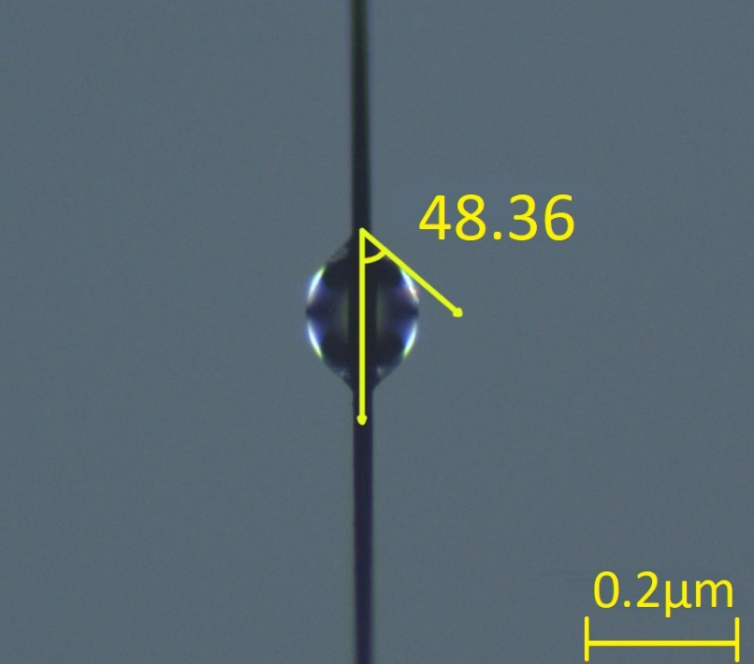
Development of nano-enhanced sizing solutions for carbon fibres

Slide 33



Development of nano-enhanced sizing solutions for carbon fibres

Slide 34

Development of nano-enhanced sizing solutions for carbon fibres
Single fibre push out test results
The enhanced performance of N₂-functionalized nanoparticles can be attributed to their chemical affinity with the sizing solution.
HP206 is amine-dispersed
N₂ functionalization introduces C-N bonds (XPS)
NH₃ functionalization introduces C-N bonds (XPS) but less than N₂ (XPS)
O₂ functionalization introduces C-O bonds (XPS)

Slide 35

IV. Upgrade and evaluation of chemically recycled carbon fibres

Slide 36









Upgrade and evaluation of chemically recycled carbon fibres
Plasma assisted solvolysis
Continuous Carbon Fibre Reclamation
Plasma assisted solvolysis
or Chemical assisted treatment
Chemical assisted solvolysis
Composite specimen manufactured with Filament Winding
Continuous recycled Fibre winding

Slide 37










Upgrade and evaluation of chemically recycled carbon fibres
Reference Fibre x1000
Plasma Recycled Fibre x1000
Plasma Recycled & Sized Fibre x1000
Chemically Recycled Fibre x1000
Chemically Recycled & Sized Fibre x1000
100% Carbon
100% Carbon
94% Carbon
67% Carbon
90% Carbon
EDS analysis of reference fibre
EDS analysis of plasma recycled fibre
EDS analysis of plasma recycled & sized fibre
EDS analysis of chemically recycled fibre
EDS analysis of chemically recycled & sized fibre
Reference Results:
Smooth rigged surface
Plasma Results:
No resin residues after recycling
No visual filament damage
Good surface morphology after sizing
Chemically assisted Results:
Few resin residues after recycling
No visual filament damage
Few resin spots after sizing

Slide 38



Upgrade and evaluation of chemically recycled carbon fibres
Reference Fibre
Plasma Recycled & Sized Fibre
Chemically Recycled & Sized Fibre
TGA Results:
CF maintain their structural integrity for both recycling cases
There is ~3% resin residue on the CF from chemically recycling process

Slide 39


Optical Microscopy Analysis

Slide 40


Upgrade and evaluation of chemically recycled carbon fibres
10min polishing
20min polishing

Slide 41


Upgrade and evaluation of chemically recycled carbon fibres
Filament count 14856 ± 1294
8.7%
Olympus
software
Filament count 23700 ± 1391
5.9%
ImageJ
Filament count 23725 ± 820
3.5%
Python

Slide 42


Upgrade and evaluation of chemically recycled carbon fibres
Tensile tests on yarns (ASTM D4018)
Sample code​ | Tensile strength (GPa)​ | % to ref​
Reference​ | 2.7 ± 0.3​ | N/A​
Plasma Recycled | 2.1 ± 0.3​ | -22​
Plasma Recycled & Sized | 2.4 ± 0.4​ | -11​
Chemically Recycled | 2.2 ± 0.2​ | -18​
Chemically Recycled & Sized | 2.4 ± 0.3​ | -11​
Filament exhibits a 10% decrease in the sized recycled fibre
Unsized fibre exhibits quite lower tensile strength (~22%), probably due to the non uniform shape of the rod

Slide 43

Upgrade and evaluation of chemically recycled carbon fibres

Slide 44


Upgrade and evaluation of chemically recycled carbon fibres
The produced CNTs have been characterized in terms of their morphology (SEM)
SEM images of produced CNTs
Homogenous sample
CNTs/CNFs with diameters from 25nm to >100nm

Slide 45

V. Future work
Sustainable sizing formulations

Slide 46
Sustainable sizing formulations
Conventional sizings for CFs typically are epoxy-based emulsions
epoxy sizing agent,
film formers,
antistatic agents
surfactants
in a solid content of 0.5-5%
Minimize environmental impact
Reduce carbon footprint of manufacturing process
Sustainability in composite materials industry
“Green” alternatives*
*Bio-based raw materials*
derivatives from lignocellulosic biomass
plant based phenolics
vegetable oils
terpenes
& replacement of organic solvents of the sizing solutions, to aquatic

Slide 47






Dionisis Semitekolos
diosemi@chemeng.ntua.gr
R Nano NTUA

